Slide 1

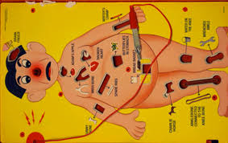
MEDICAL RECORDS
Admissabilty:
Hearsay exceptions
Authentication
Who can sponsor the evidence?
What can it be used for?
How to get it in?
What to do with it?
Raising broader issues

Slide 2
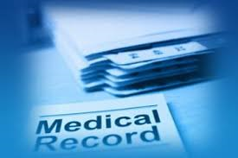
MEDICAL RECORD EXHIBITS:
Exhibit D: Ambulance “run report”
Exhibit E: Clearwater Hospital Discharge Summary
Exhibit F: Clearwater Medical Group progress note

Slide 3

CASE STIPULATIONS
1. All of the exhibits are authentic and the authenticity of an exhibit is never at issue. Authentic exhibits are not necessarily admissible at trial.
5. This case is bifurcated as to liability and damages. Liability is being tried in this case; if Smid is successful, damages will be tried on a later date.

Slide 4
CASE STIPULATIONS
6. While certification pages were not provided, both sides agree that Exhibit D (ambulance report), Exhibit E (hospital report), and Exhibit F (prior medical report) were properly certified. Additionally, both parties provided proper pretrial notification regarding the use of Exhibits D, E, and F under Rule 803(6m).

Slide 5
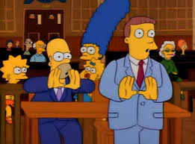
At its core, hearsay is nothing more than:
  A statement
  Made out of court
  Being offered as the truth

Slide 6
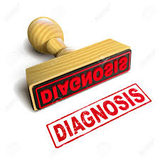
Sammy Smid
“I have been diagnosed with a seizure disorder.”

Slide 7
Wis. stat. § 908.03
These exceptions are generally utterances made contemporaneously with some physical perception or experience (present sense impression, excited utterance, etc.), or
Records that document some benign or non-controversial event, or reputable publications (marriage records, birth certificates, learned treatises, etc...)

Slide 8
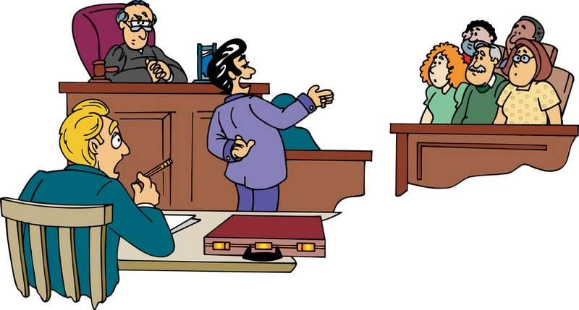
Rule 803
“The following are not excluded by the hearsay rule, even though the declarant is available as a witness…”

Slide 9
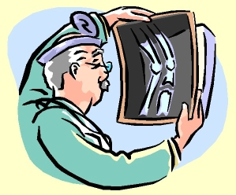
803(4)
(4) Statements for purposes of medical diagnosis or treatment. Statements made for the purpose of medical diagnosis or treatment.

Slide 10
(6m) Patient Health Care Records. Authentication witness unnecessary. A custodian or other qualified witness required by sub. (6) is unnecessary if the party who intends to offer patient health care records into evidence at a trial or hearing does one of the following at least 40 days before the trial or hearing:
i. Serves upon all appearing parties an accurate, legible and complete duplicate of the patient health care records for a stated period certified by the record custodian.
ii. Notifies all appearing parties that an accurate, legible and complete duplicate of the patient health care records for a stated period certified by the record custodian is available for inspection and copying during reasonable business hours at a specified location within the county in which the trial or hearing will be held.
Presumption. Billing statements or invoices that are patient health care records are presumed to state the reasonable value of the health care services provided and the health care services provided are presumed to be reasonable and necessary to the care of the patient.

Slide 11
CASE STIPULATIONS
6. While certification pages were not provided, both sides agree that Exhibit D (ambulance report), Exhibit E (hospital report), and Exhibit F (prior medical report) were properly certified. Additionally, both parties provided proper pretrial notification regarding the use of Exhibits D, E, and F under Rule 803(6m).

Slide 12
WHY??
Hakenkord v. State, 100 Wis. 2d 452 (1981)
“In respect to the hearsay rule, a hospital record clearly falls within the category of evidence that is so reliable that no only factual observations recorded in hospital records but medical opinions and diagnosis may be admitted into evidence upon compliance with the procedural rules even though the declarants, the makers of the records, are available for cross examination.”

Slide 13
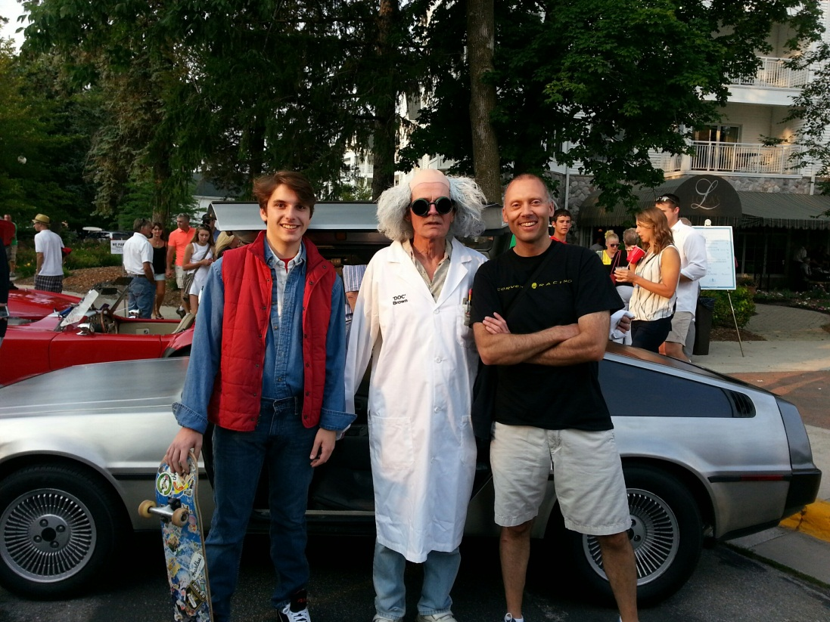
Hearsay and experts
703 allows an expert to rely on otherwise inadmissible evidence to formulate opinions.
HOWEVER…
That evidence must be the kind regularly relied upon by experts in their field.
Is it??

Slide 14
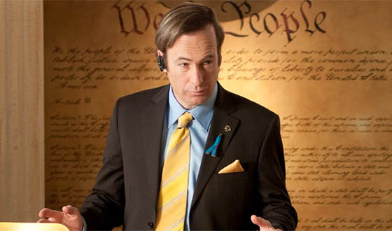
Common mistakes in offering exhibits…
Not adequately explaining to the jury what it is
Ignoring the exhibit after admission
Not using the exhibit with other witnesses as warranted
Not referencing to the exhibit in closing

Slide 15
Raising Broader Issues…
Support the broader goals of mock trial as a program:
  Better understanding of not only how the legal system works, but why
  Spark discussion of moral and societal issues
  How the case relates to real life current events
  Teaching critical thinking skills that translate to other areas of life

Slide 16
Raising Broader Issues…
The Ferguson case
Frank Jude
Burden of Proof: civil vs. criminal
  Simpson trial, not guilty but found civilly responsible
What is the rationale behind certain rules
Guest speaker?
Solutions?

Slide 17
https://www.youtube.com/watch?v=e7jggCcfyjE

